Slide 1
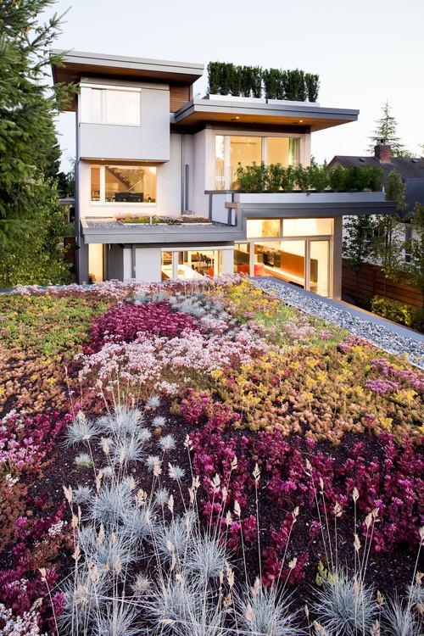
Useful home Gardening
Good morning
Good morning
NagarajahThishanth

Slide 2
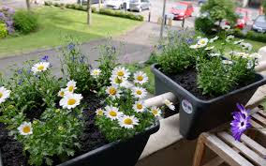
What is the home gardening?
The act of cultivating or tending some useful plants near the house.
.

Slide 3
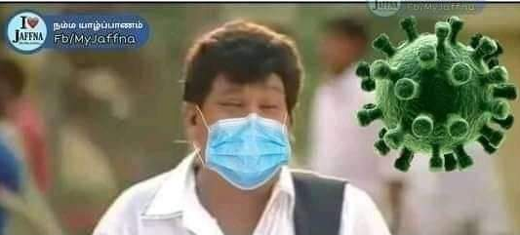
Why we should make the home garden in this time?

Slide 4
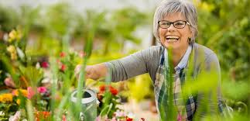
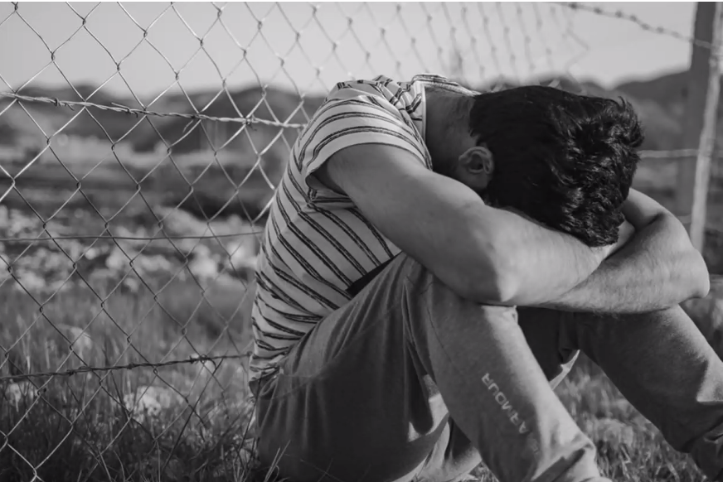
Advantage of home gardening
Boosts mood.
Reduces stress.
.

Slide 5
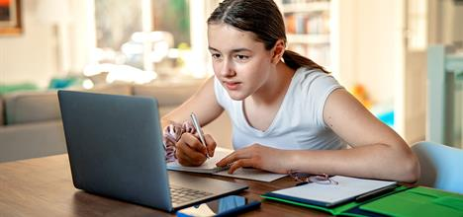
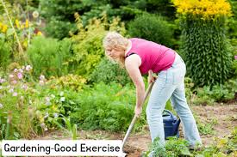
We can preservation our eyes and body. It is a good exercise.

Slide 6
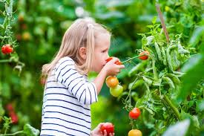
We can get new healthful fruits and vegetable in the home garden.

Slide 7
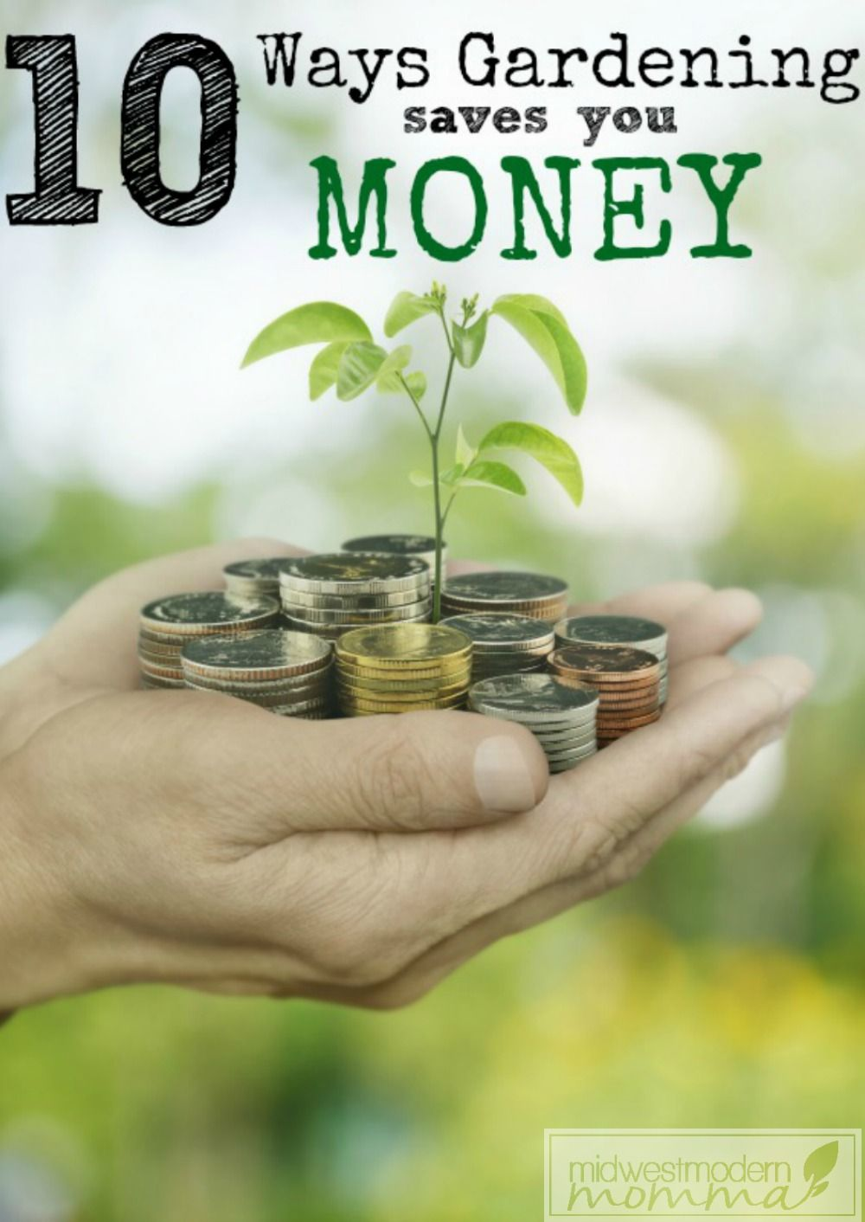
One of the benefits of enjoying garden vegetables is a reduced monthly food bill.

Slide 8

What can gardening teach you?
Children learn from growing things
Understanding

Slide 9
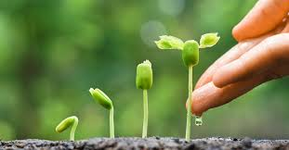
Self-confidence

Slide 10
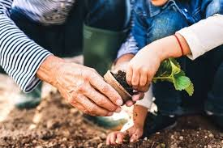
Responsibility.

Slide 11
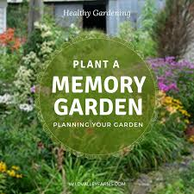
Improves memory.
We get many benefits from creating a home garden

Slide 12
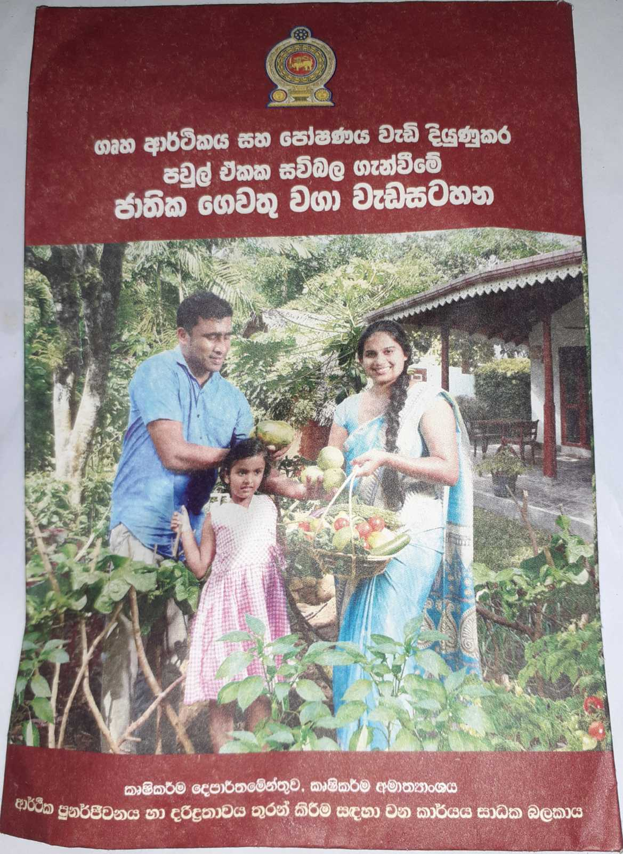
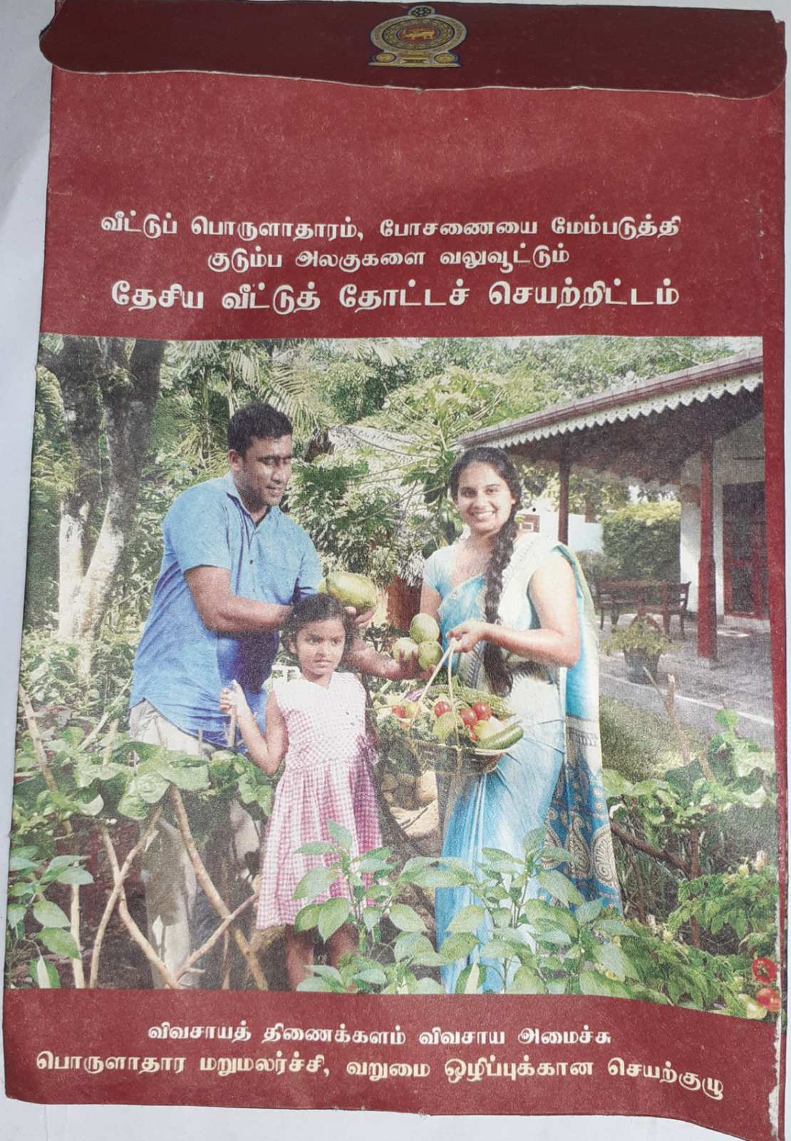
Our government is advising to make the home garden and it giving some free plant's seeds in this corona time.

Slide 13
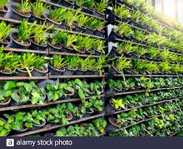
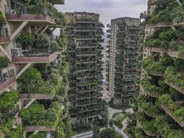
Town site people can use many trick to make home garden so we can make gardening any places.

Slide 14
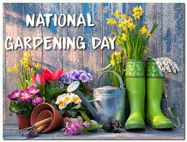
NATIONAL GARDENING DAY – April 14
GARDENING: SAVE THE WORLD - Environmental Benefits ..
https://www.youtube.com/watch?v=nwd9cuZNOMo
Healthy Gardens, Healthy Gardeners
https://www.youtube.com/watch?v=Xo9hQS1wz-A

Slide 15
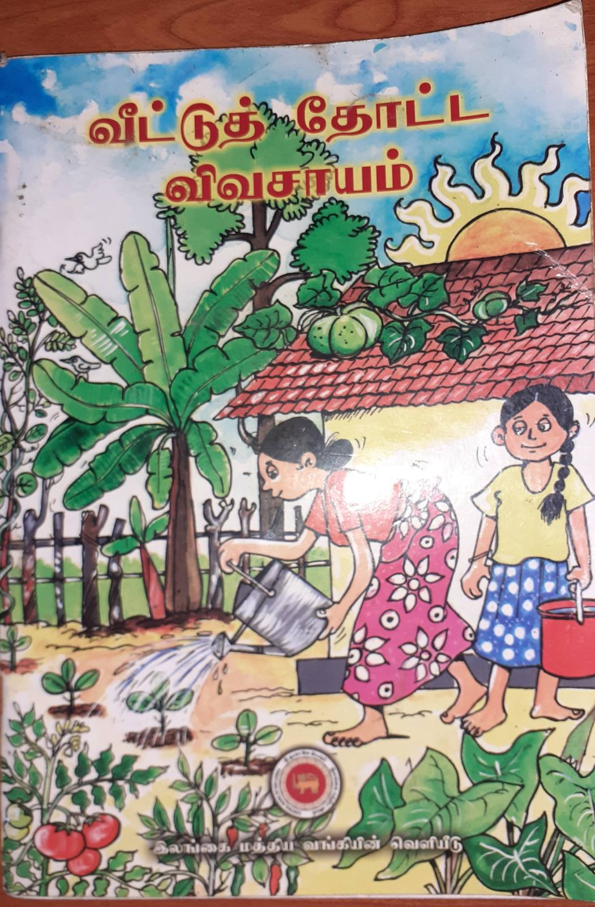
Thank you
I used Wikipedia, Google and some books to create this presentation

